Slide 1
Threads and OpenMP
Finding Prime Numbers

Slide 2
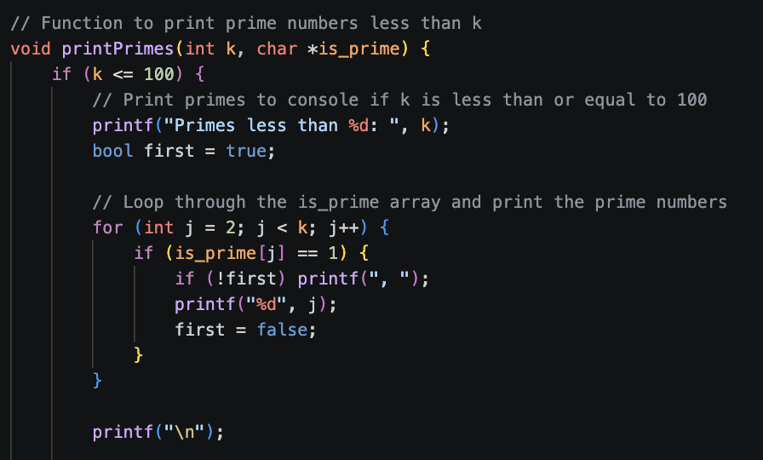
Task 1 Serial Code (printPrimes) pt. 1
Print primes to console (standard output) if k is less than or equal to 100.

Slide 3
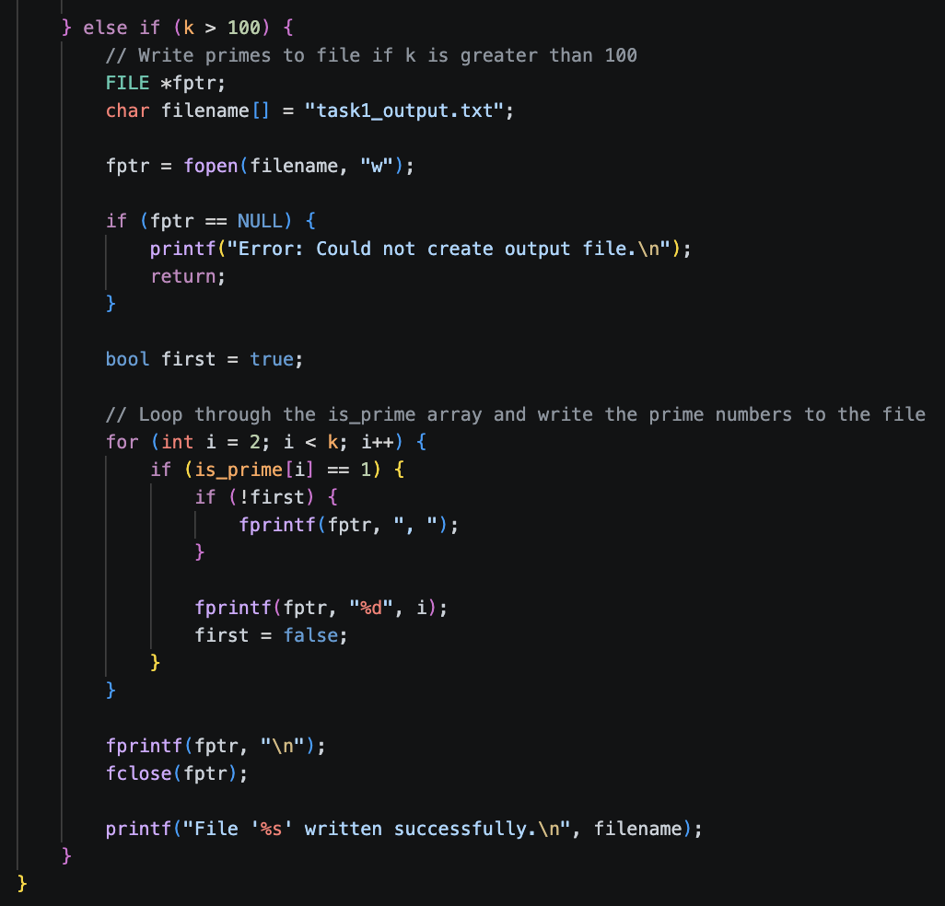
Task 1 Serial Code (printPrimes) pt. 2
Outputs primes to a text file (.txt) if k is more than 100.

Slide 4
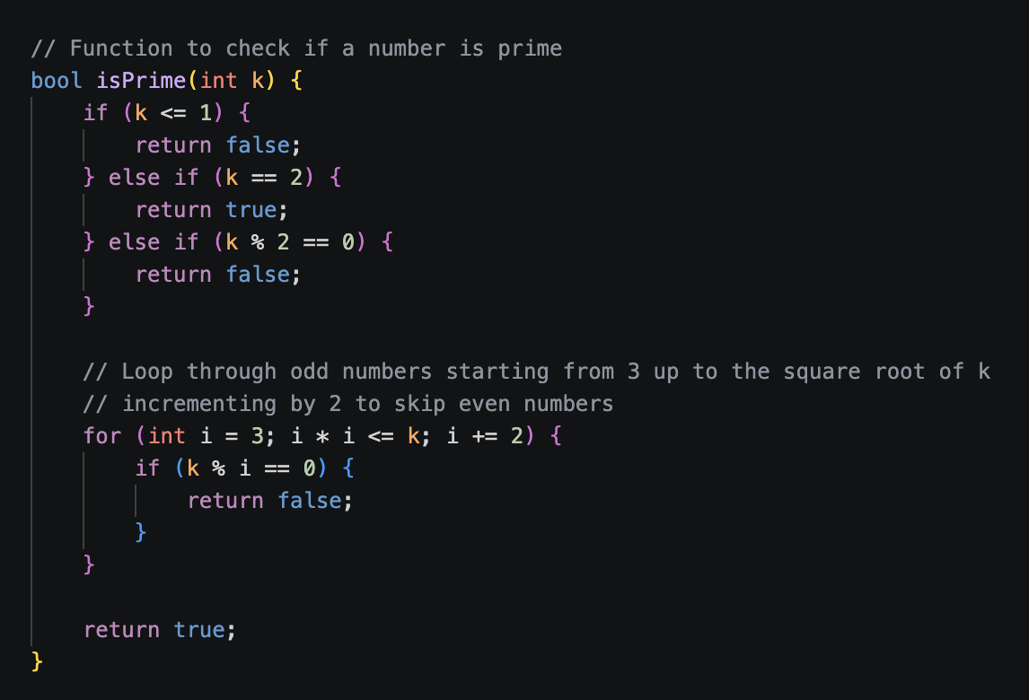
Task 1 Serial Code (isPrime)
Coded instant return values for 0, 1, 2, and even numbers.
Starts from 3 in the loop equivalently up to the square root of k.
Increments by 2 to skip even numbers.

Slide 5
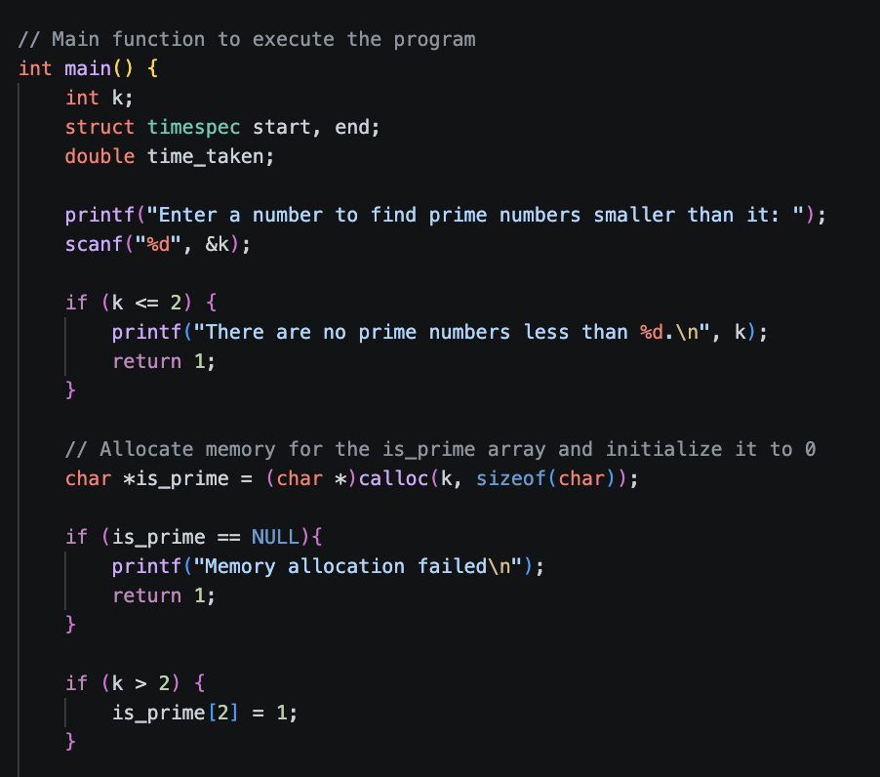
Task 1 Serial Code (main) pt. 1
Scans user input, returns early if the input is 2 or less.
Uses calloc to store primes.
Initialises the default value for is_prime array.

Slide 6
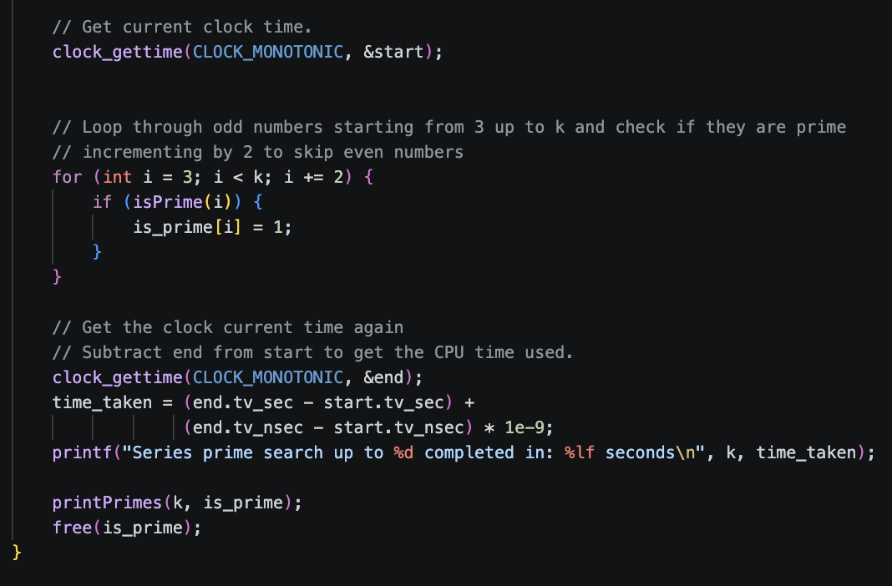
Task 1 Serial Code (main) pt. 2
Gets time before and after the computation to get the most accurate computational time.
Starts from 3 in the loop up to k.
Increments by 2 to skip even numbers.

Slide 7
Task 2 and 3 Basic info
Majority of the code is the same as task 1 for both task 2 and task 3.
Additional functions will be mentioned.
Prime storing and printing logic is the same.
Only difference is the computational logic so that measurements and testing will be more consistent (more constant variables as to not affect outcome).
Code is assumed to be the same if not mentioned.

Slide 8
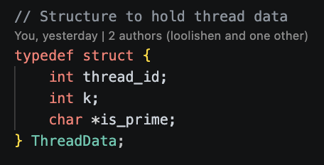
Task 2 POSIX Threads (ThreadData struct)
Structure to hold thread data

Slide 9
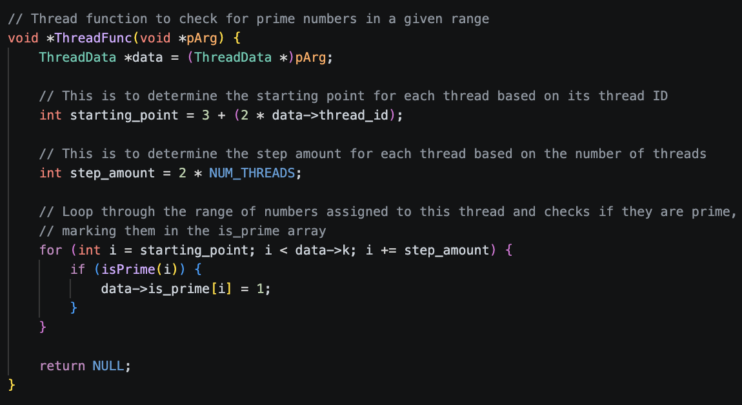
Task 2 POSIX Threads (ThreadFunc)
Thread function to check for prime numbers using the same logic as task 1.
Calculates a distinct starting point 3 + (2 * thread_id) and stride 2 *NUM_THREADS to implement static partitioning.

Slide 10
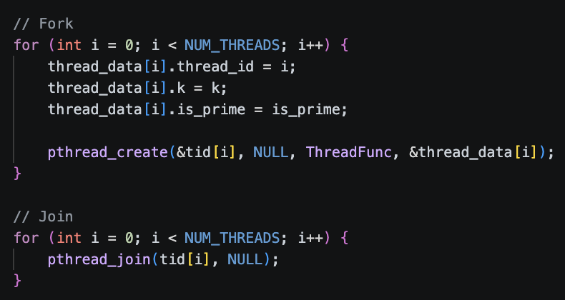
Task 2 POSIX Threads (main)
Basic loops to fork the process into multiple threads and joining back the results.

Slide 11
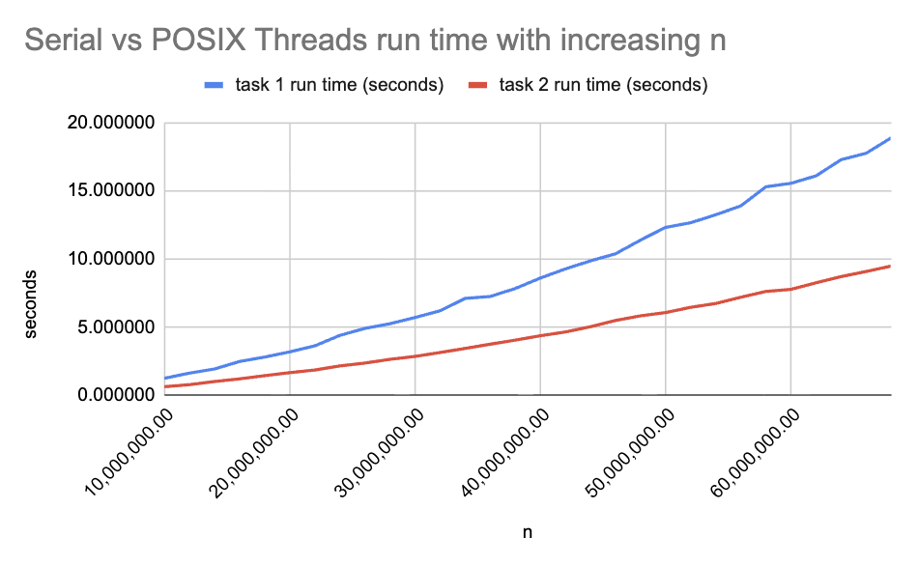
Task 2 POSIX Threads (graph 1)
Task 2 was run with 2 threads for this graph comparison.
Task 1 is serial (runs on 1 thread).

Slide 12
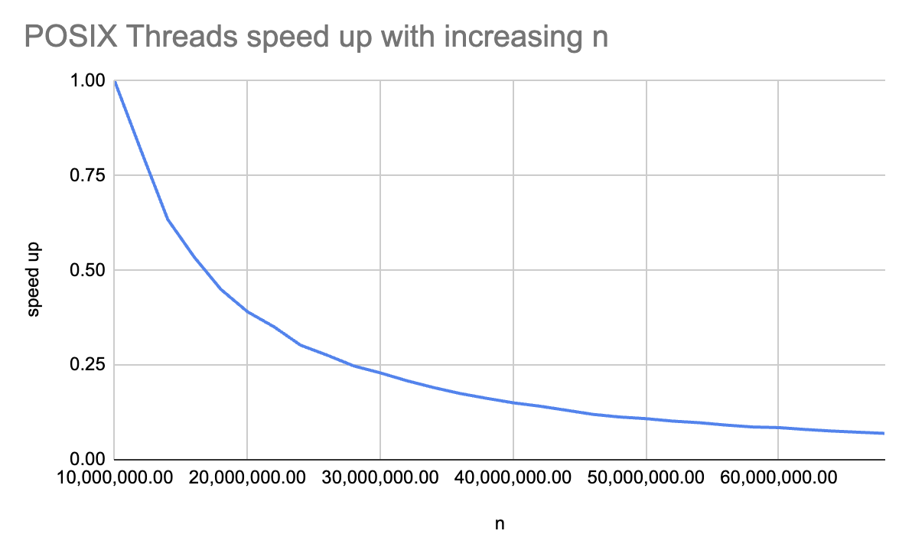
Task 2 POSIX Threads (graph 2)
Task 2 was run with 2 threads for this graph comparison.
The speedup was calculated with the formula of base time at 10,000,000 n divided by the time at the current n.
(base time / current time)

Slide 13
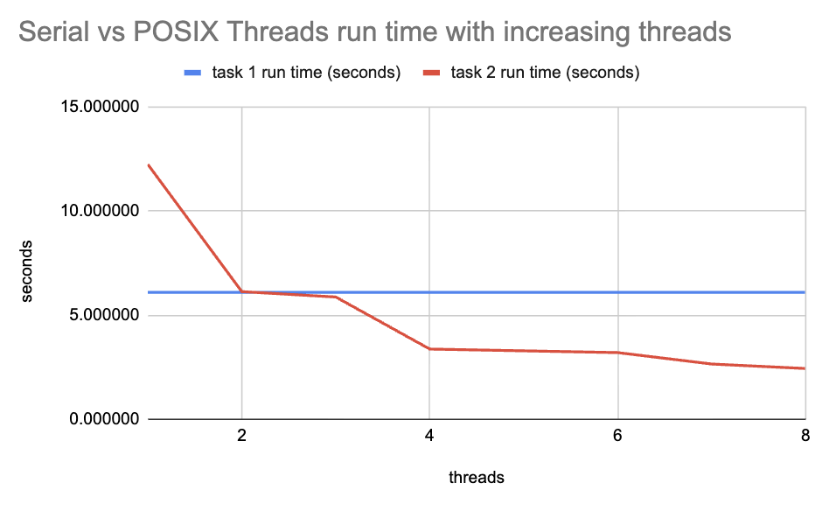
Task 2 POSIX Threads (graph 3)
Task 1 is serial (runs on 1 thread).
Task 2 was run with increasing threads.
n was set at 50,000,000 for this graph comparison.

Slide 14
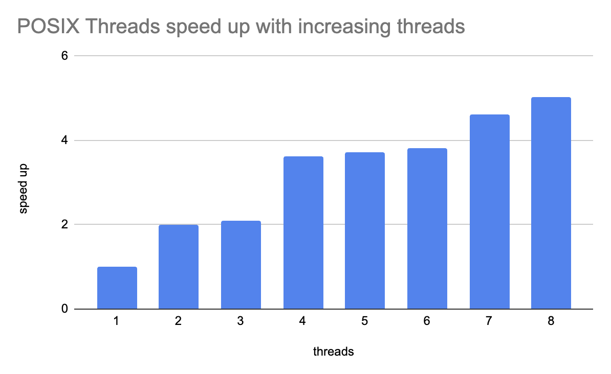
Task 2 POSIX Threads (graph 4)
n was set at 50,000,000 for this graph comparison.

Slide 15
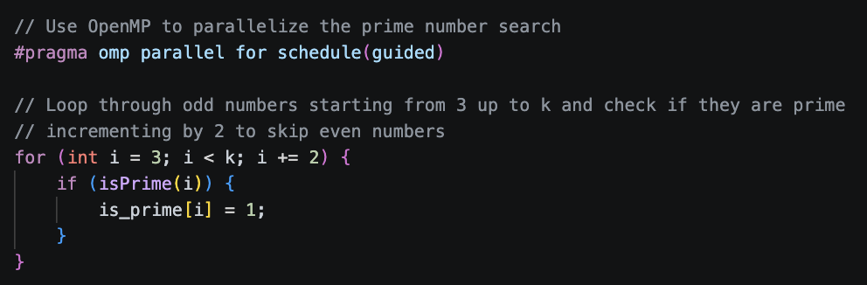
Task 3 OpenMP (main)
Essentially the same as task 1 apart from the pragma omp parallel call to utilise OpenMP parallelization.
Guided partition scheme is used as prime finding has an uneven workload which guided is best at.

Slide 16
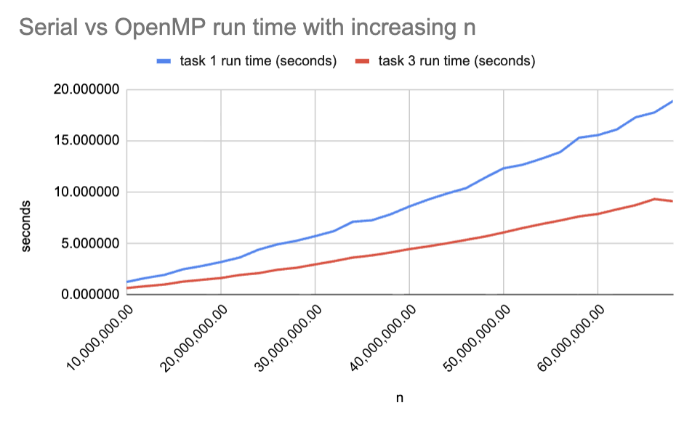
Task 3 OpenMP (graph 1)
Task 3 was run with 2 threads for this graph comparison.
Task 1 is serial (runs on 1 thread).

Slide 17
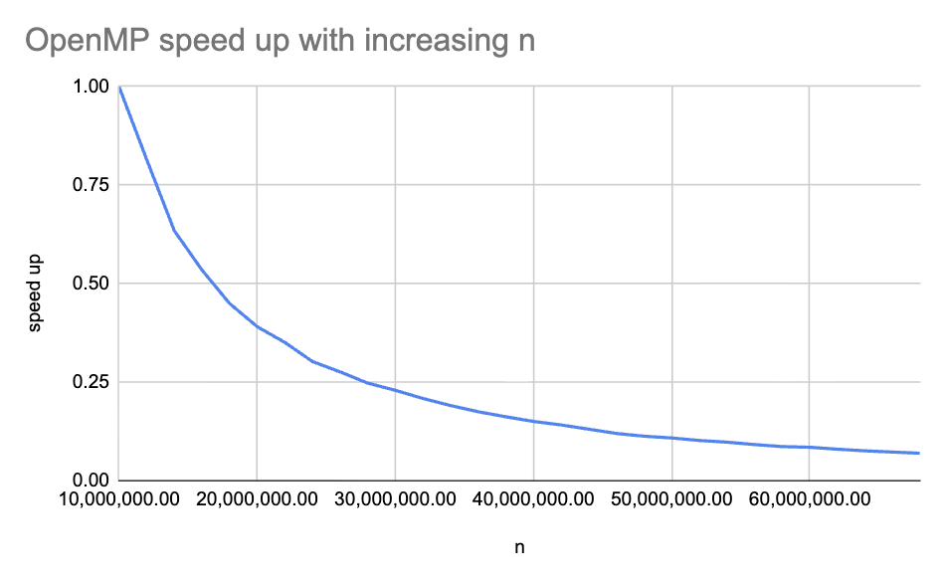
Task 3 OpenMP (graph 2)
Task 3 was run with 2 threads for this graph comparison.
The speedup was calculated with the formula of base time at 10,000,000 n divided by the time at the current n.
(base time / current time)

Slide 18
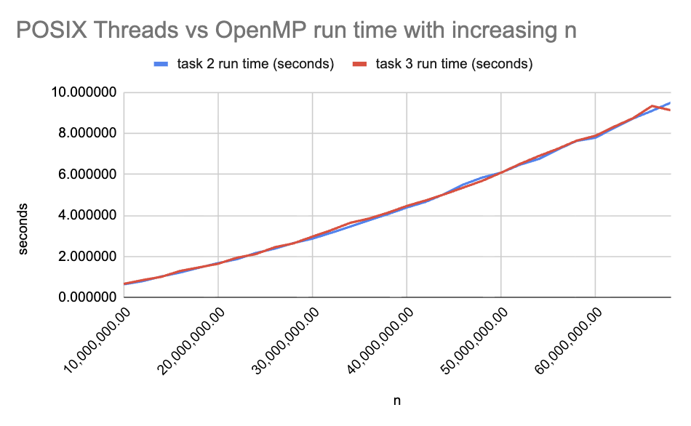
Task 3 OpenMP (graph 3)
Both task 2 and task 3 was run with 2 threads for this graph comparison.

Slide 19
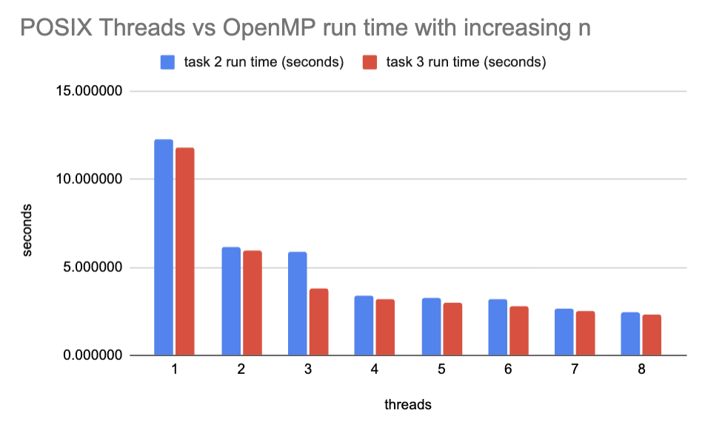
Task 3 OpenMP (graph 4)
n was set at 50,000,000 for this graph comparison.

Slide 20
Conclusion and Recommendations
Parallelization is extremely useful to fully utilise your machine’s functions to speed up processes.
Use POSIX threads (pthreads) for parallelization if more control over parallelization is wanted.
Use OpenMP (omp) for parallelization if convenience is wanted as there are more inbuilt functions that are useful.
Do not use more threads than the cores available on your machine as the process will slow down instead (context switching is used in this scenario).

Slide 21
Q&A
Thank you for your attention

